Slide 1
MCIS 5133 Data & Information Management
Week2_Introduction to Databases
Dr. Ahmad Al Shami

Slide 2
Topics Covered
What is a Database?
Database Components
Database Configurations
The Relational Database Model
Relational Database Features
Designing a Database
Example – ERD for an Order Processing System

Slide 3
2.1 What is a Database?
A database is an organized collection of integrated, non-redundant and shareable data.
Integrated – refers to “relationships” between data that may be stored in physically separate structures.
Non-redundant – refers to achieving these relationships without unnecessary duplication of data.
Shareable – refers to the ability of data to be shared by multiple users, potentially at the same time.

Slide 4
2.1 What is a Database?
A database helps the company manage it’s most important resource - DATA
keep data organized and up-to-date
make data available on demand (information)
process transactions for the daily operations of the company (information)
analyze existing data to help the company make decisions (knowledge)
What type of business would use a database?

Slide 5
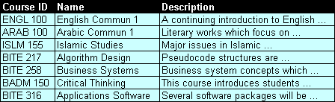
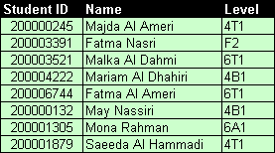
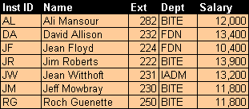
2.2 Database Components
Data
Software
People
COURSE
D
B
M
S
Teacher (Mark Entry)
STUDENT
HR (Payroll)
FACULTY
Data definition
Data retrieval
Integrity
Data independence
Concurrency
Security & privacy
Backup & recovery
Student Services (Registration)

Slide 6
2.2 Database Components
1. Data
Source data – the main data
Meta data – data that describes the objects in the database (tables, views, users, etc.)
Overhead data – special data used to represent relationships and improve performance
2. Software
Database management system (DBMS) – software needed to perform basic data definition and retrieval, as well as data management issues such as integrity, concurrency, security, etc.
Application programs that process the data in order to perform a business task (eg, order processing).

Slide 7
2.2 Database Components
Database applications may be written specifically for a client computer …

Slide 8
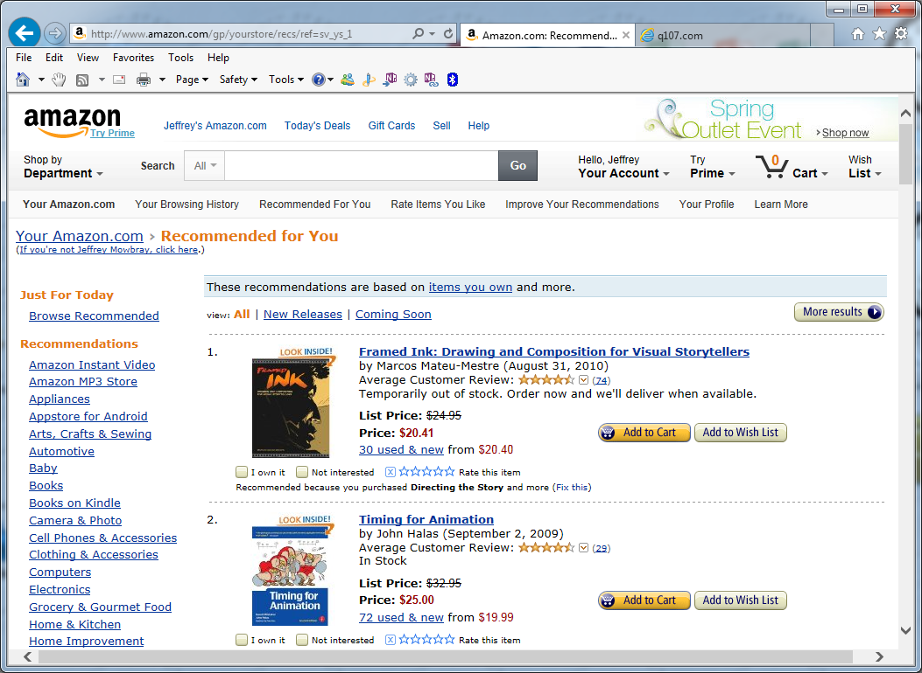
2.2 Database Components
… or they may be Web-based.

Slide 9
2.2 Database Components
3. People
End-users – (non-technical) - use the database to perform business-related tasks (operational, managerial, customers, etc.).
Developers / designers – programmers and other computer software specialists that design the database structures and the application programs that process the data.
Database Administrator (DBA) - responsible for the overall control of the database system, including maintaining user accounts, security and integrity checks, backup and recovery procedures, performance monitoring, etc.

Slide 10
2.3 Database Configurations
Standalone Databases
The database, DBMS and application programs are stored on a single PC. Individual users must manage and maintain their own data. Data is not shared with other users.
Intended for small businesses or personal use.
Database
Examples:
MS Access
FileMaker Pro
Paradox
DBMS
Application(s)
Application(s)
Application(s)
Standalone PC
Notes:
Advantages
PC are inexpensive and easy to use
Lots of PC databases and development tools available
Individual users manage and maintain their own data
Disadvantages
Data becomes isolated
Data is not readily available to all users who need it

Slide 11
2.3 Database Configurations
Client-Server Databases
The database and DBMS is stored on a central computer (server), while applications run separately on user (client) computers.
Examples:
Oracle
SQL Server
DB2
Database Server
Database
DBMS
Network / Internet
Database Clients
Application(s)
Application(s)
Application(s)
Application(s)
Application(s)
Application(s)
Application(s)
Application(s)
Application(s)
Notes:
Advantages
Better performance / minimal network traffic (load is split between client and server)
Easier to modify hardware configuration
Sophisticated DBMS / development tools
Disadvantages
Difficult to administer and maintain

Slide 12
2.3 Database Configurations
Distributed Databases
The database is spread across multiple storage devices, which may be attached to physically separate servers.
DB pt 1
Database Servers
Distributed DBMS
DB pt 2
DB pt 3
Network / Internet
Database Clients
Application(s)
Application(s)
Application(s)
Application(s)
Application(s)
Application(s)
Application(s)
Application(s)
Application(s)

Slide 13

2.4 The Relational Database Model
In the 1960s, mainframe computers used complex database systems that were difficult to use and maintain.
Dr. E. F. Codd, a mathematician working for IBM in California, proposed an alternative to these systems in 1969 when he developed the “Relational Database Model”.
According to Codd, a 2-dimensional table (or file) was referred to as a “relation” (a related set of information), hence the term “relational model”.
The first commercial product based on this model was System R – released by IBM in 1974.
Codd’s relational model also inspired a young entrepreneur named Larry Ellison, who formed Oracle Corp. in 1982.

Slide 14
2.5 Relational Database Features
Table-Based Structure
In a relational database, data is stored in 2-dimensional tables that represent real-world objects.
A table is a model of a real-world object (person, place or thing) that a company wishes to keep data about.
A record is a row in a table (all data about one example of the object).
A field is column in a table (data that “describes” the object).
EMPLOYEE

Slide 15
2.5 Relational Database Features
Table-Based Structure
Tables in a relational database also have the following features:
rows / columns have no particular order
column values must be from the same domain (data type)
only 1 value allowed in each “cell”
EMPLOYEE

Slide 16
2.5 Relational Database Features
Primary Key
A primary key is a field(s) that uniquely identifies a record in a table. In other words, every record must be unique.
EMPLOYEE
primary key
“Entity Integrity”
All tables must have a primary key whose values are unique and non-null.

Slide 17
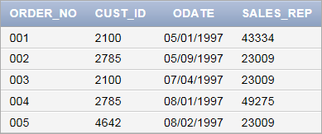
2.5 Relational Database Features
Relationships between Tables
Relationships between tables are implemented using a foreign key – a field in one table whose values match the values in another table.
primary key
ORDER
“Referential Integrity”
A foreign key value cannot exist unless a matching value exists in a corresponding primary key field.
A foreign key value may be null.
foreign key

Slide 18
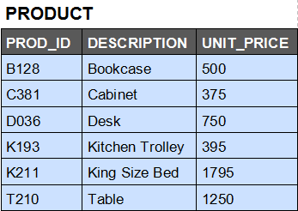
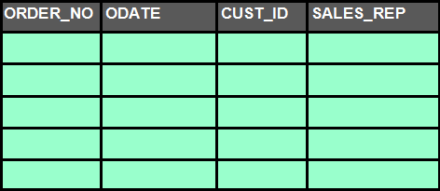
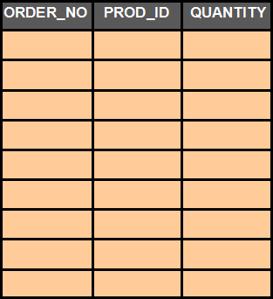
2.5 Relational Database Features
Relationships between Tables
In the following, identify the primary and foreign keys
CUSTOMERS
ORDER
ORDER_LINE
001 01-May-97 2100 43334
001 B128 5
002 09-May-97 2785 23009
001 C381 3
003 04-Jul-97 2100 23009
002 B128 6
004 01-Aug-97 2785 49275
003 C381 1
005 02-Aug-97 4642 23009
003 D036 2
003 T210 2
004 D036 15
005 B128 1
005 D036 5

Slide 19
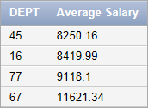
2.5 Relational Database Features
Operations on Tables
Any operation on a table (or tables) will also result in a table.
EMPLOYEE
select DEPT, round(avg(SALARY),2) " Average Salary"
from EMPLOYEE
group by DEPT
order by avg(SALARY) asc;

Slide 20
2.6 Designing a Database
In a relational database, data must be classified and organized in a table format.
For example, an employee file might be organized like this:
When designing tables, the main objectives are
store only essential data
ensure correctness (integrity) of data
minimize storage space
eliminate unnecessary duplication of data (redundancy)
EMPLOYEE

Slide 21
2.6 Designing a Database
When designing the data in an information system, the systems analysts perform several steps:
Gather data and determine requirements
Create entities (the main “objects” that should be stored)
Create attributes (the things that describe the objects)
Create relationships (how objects are connected to each other)
Designing the data / information part of any information system is a difficult job … to make things easier, systems analysts often use an entity-relationship diagram (ERD) to represent the entities, attributes and relationships.

Slide 22
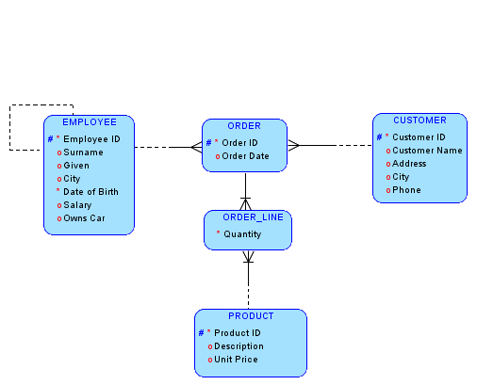
2.7 Example – ERD for an Order Processing System

Slide 23
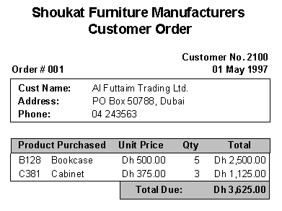
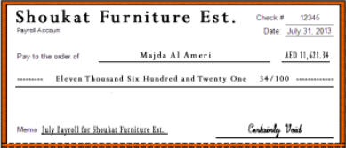
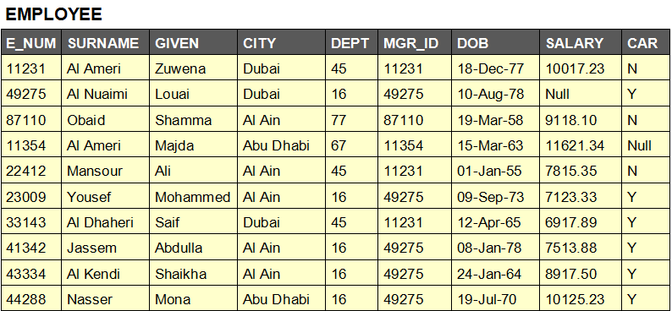
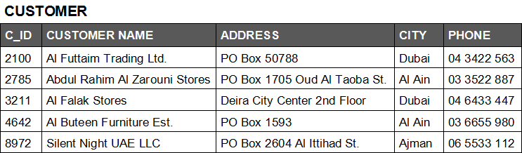
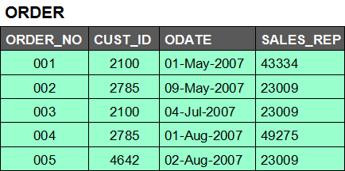
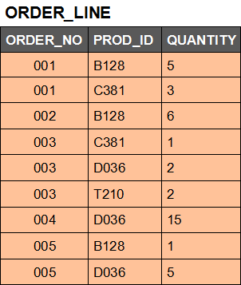
2.8 CIS 1303 – What you will Learn
Part 1 – Data Modeling (design)
Starting with these,
Develop this …
… then finally, these:

Slide 24
2.8 CIS 1303 – What you will Learn
Part 2 – Data Retrieval (Structured Query Language)
Starting with this,
Write SQL code like this …
select GIVEN, SURNAME, CITY, SALARY, CAR
from EMPLOYEES
where CITY <> ‘DeerPark'
and SALARY > 15000
and CAR = ‘N';
To produce this:

Slide 25
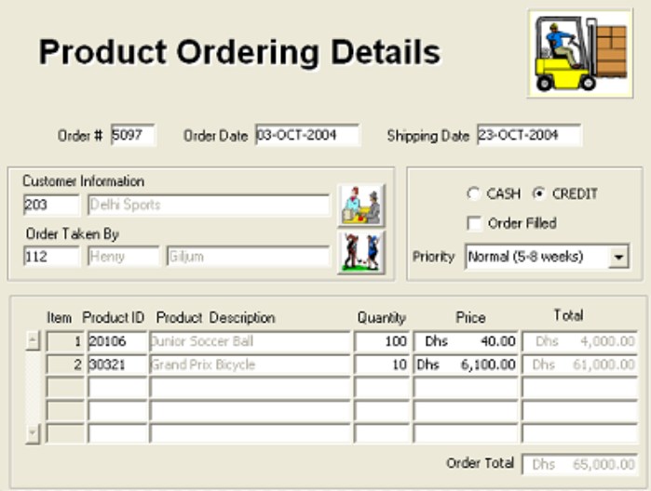
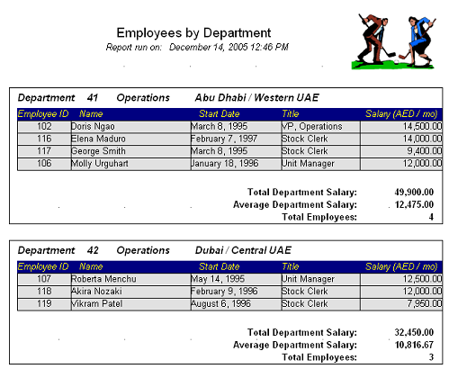
2.8 What you will Learn
Part 3 – Application Development
Starting with these,
Create forms (to input data) and reports (to output information)

